Slide 1
MILAGRO 2023 MARGARITA MOBILE TOUR RECAP
ACTIVATION DATA

Slide 2
MILES AND HOURS DRIVEN BY ACTIVATION STATE
Activation Details | Events Activated | Days in State | Miles | Time
Florida 5/3-6/2 | 29 | 30 | 1,897 | 65:36:19
California (including AZ) 6/6 - 8/16 | 29 | 69 | 5,432 | 179:28:08
Texas 8/22-9/24 | 18 | 38 | 2,150 | 36:04:02
Transportation | 0 | 15 | 4,352 | 75:38:08

Slide 3
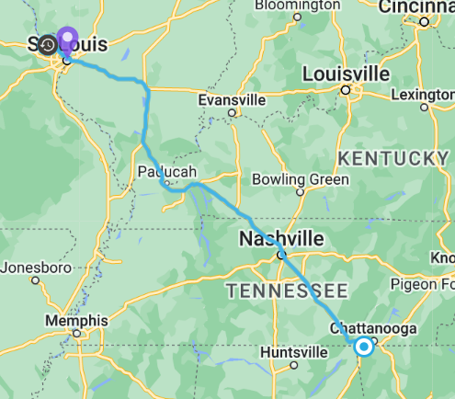
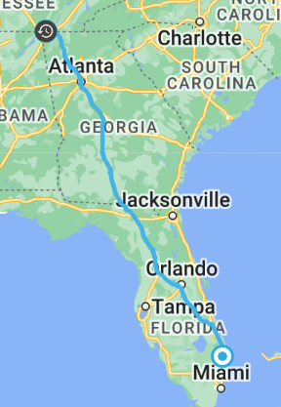
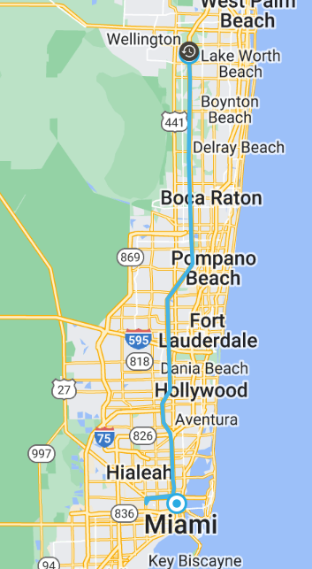
TRANSPORT TO FLORIDA
Date | Miles | Time
5/1 | 446.2 | 7:58
Date | Miles | Time
5/2 | 699 | 12:30
Date | Miles | Time
5/3 | 67.8 | 1:48

Slide 4
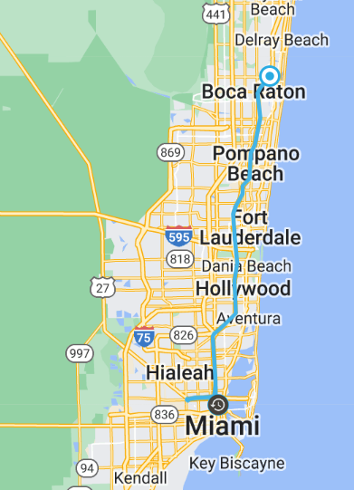
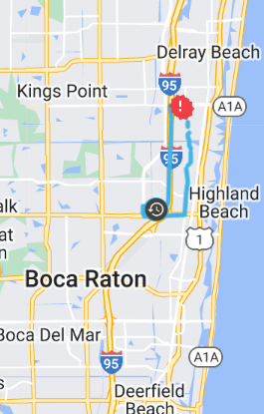
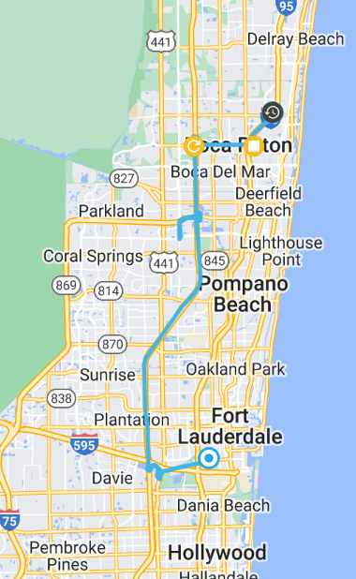
FLORIDA
Date | Miles | Time
5/8 | 52 | 1:31
Date | Miles | Time
5/9 | 6 | 0:32
Date | Miles | Time
5/10 | 41 | 2:14

Slide 5
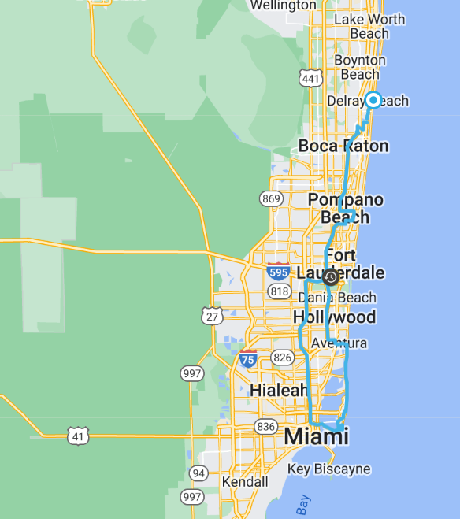
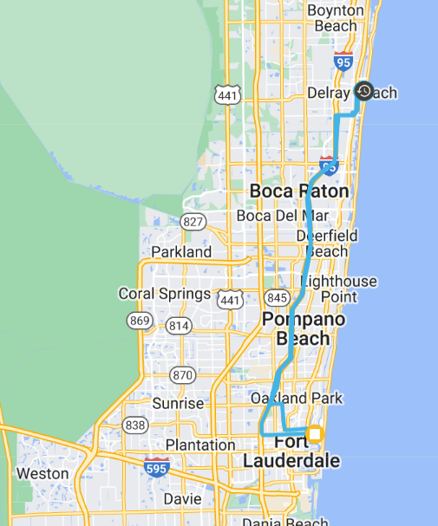
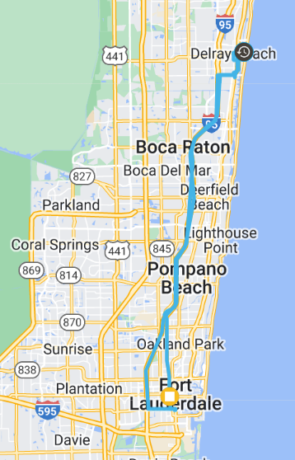
FLORIDA
Date | Miles | Time
5/11 | 85 | 3:59
Date | Miles | Time
5/12 | 56 | 2:28
Date | Miles | Time
5/13 | 58 | 3:27

Slide 6
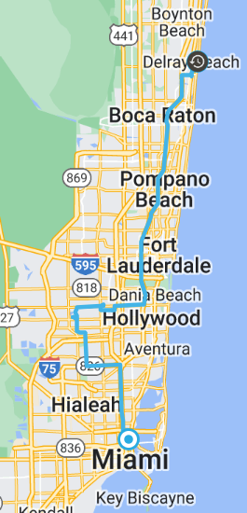
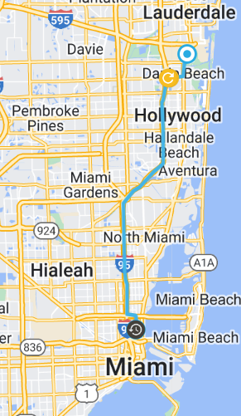
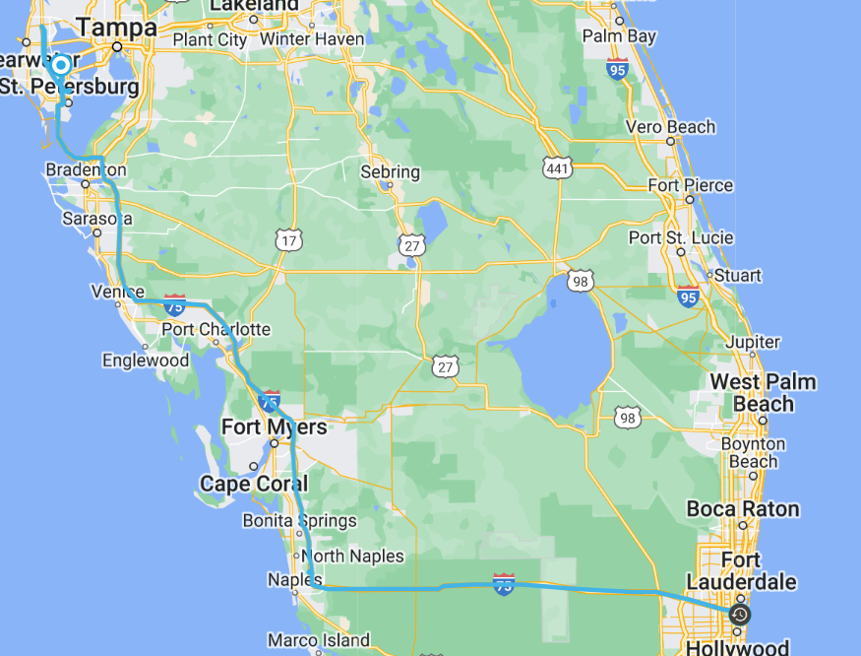
FLORIDA
Date | Miles | Time
5/14 | 66 | 2:15
Date | Miles | Time
5/16 | 22 | 0:55
Date | Miles | Time
5/18 | 298 | 5:59

Slide 7
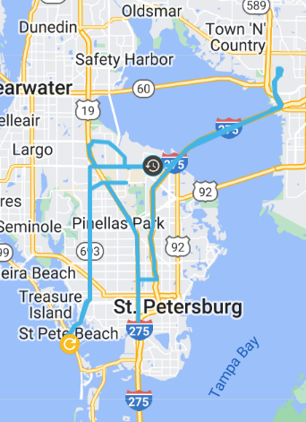
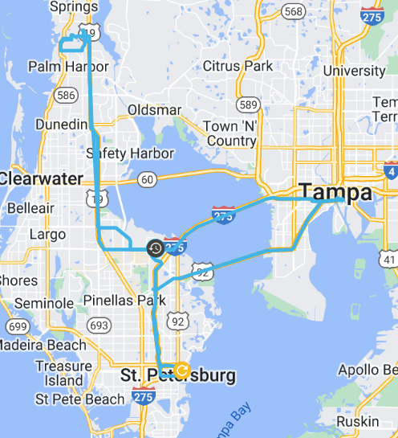
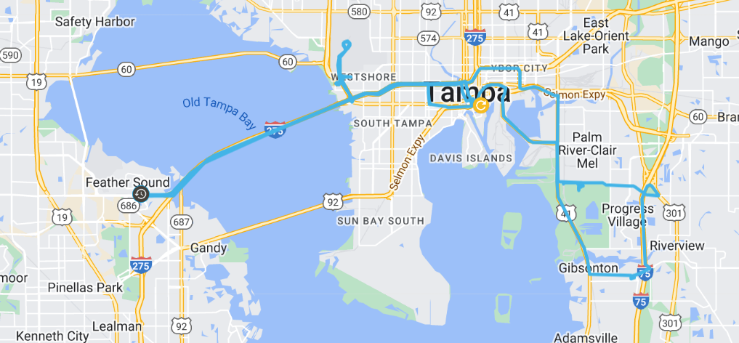
FLORIDA
Date | Miles | Time
5/19 | 100 | 3:55
Date | Miles | Time
5/20 | 98 | 4:54
Date | Miles | Time
5/21 | 93 | 3:13

Slide 8
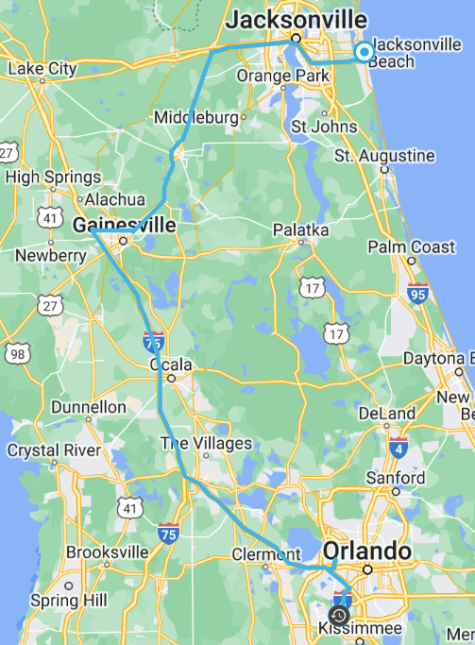
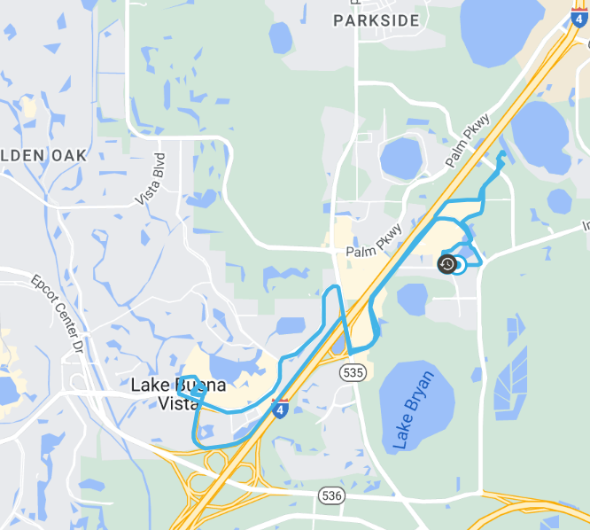
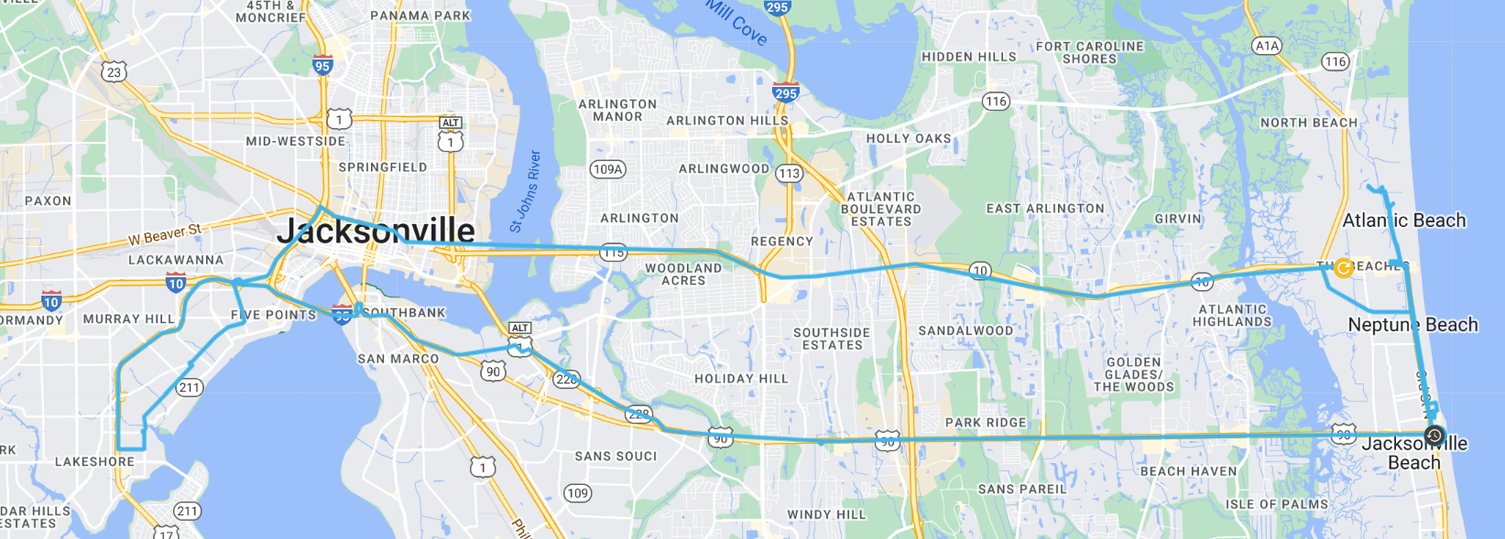
FLORIDA
Date | Miles | Time
5/25 | 11 | 0:41
Date | Miles | Time
5/26 | 229 | 4:54
Date | Miles | Time
5/27 | 53 | 2:22

Slide 9
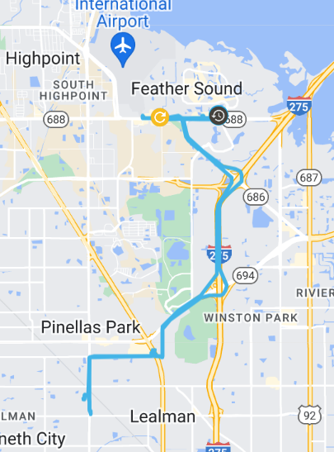
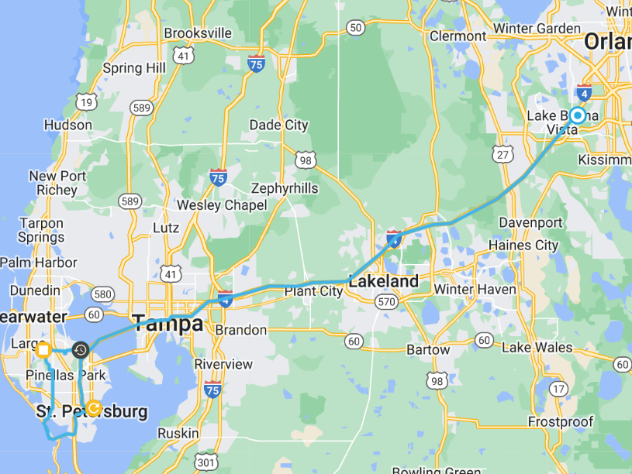
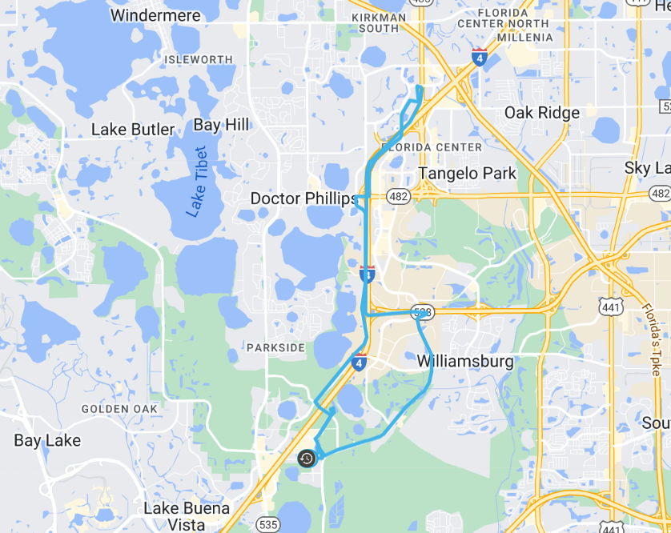
FLORIDA
Date | Miles | Time
5/22 | 18 | 1:27
Date | Miles | Time
5/23 | 125 | 3:52
Date | Miles | Time
5/24 | 17 | 0:58

Slide 10
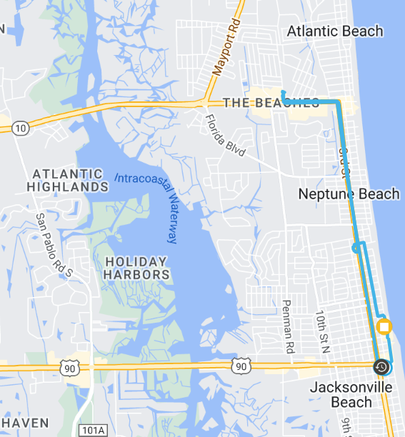
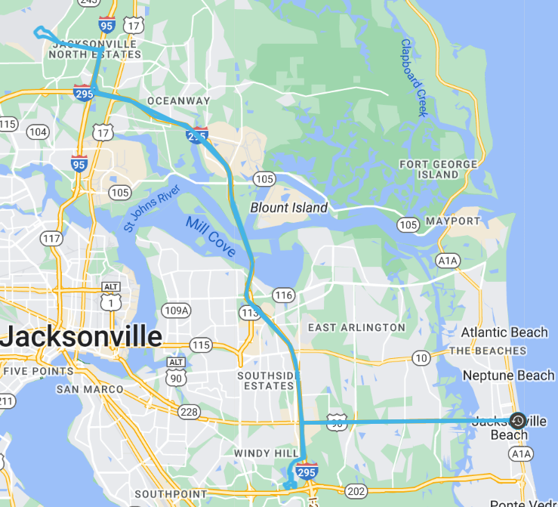
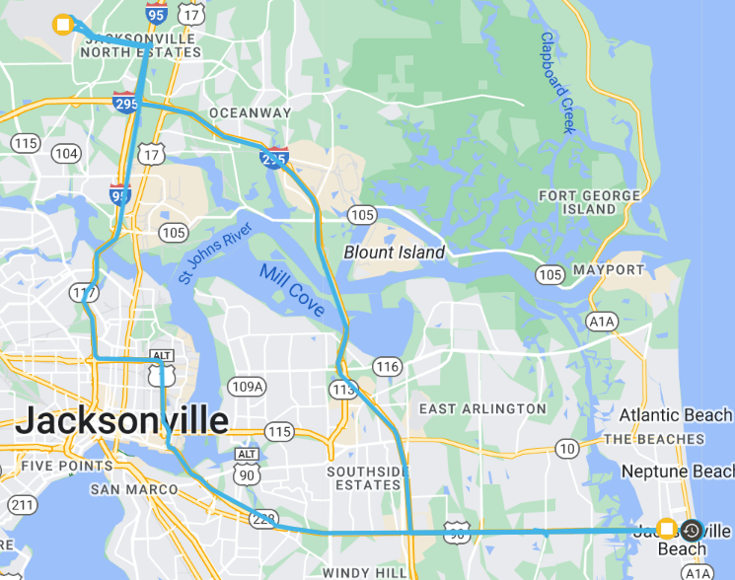
FLORIDA
Date | Miles | Time
5/28 | 6 | 1:33
Date | Miles | Time
5/29 | 75 | 2:06
Date | Miles | Time
5/30 | 63 | 2:37

Slide 11
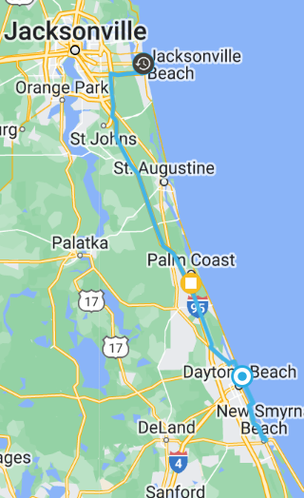
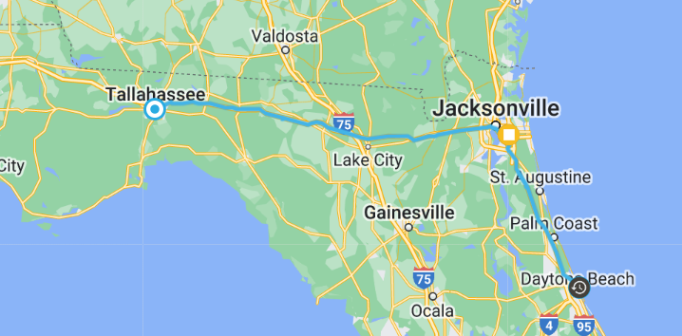
FLORIDA
Date | Miles | Time
5/31 | 126 | 3:44
Date | Miles | Time
6/1 | 5:57 | 256

Slide 12
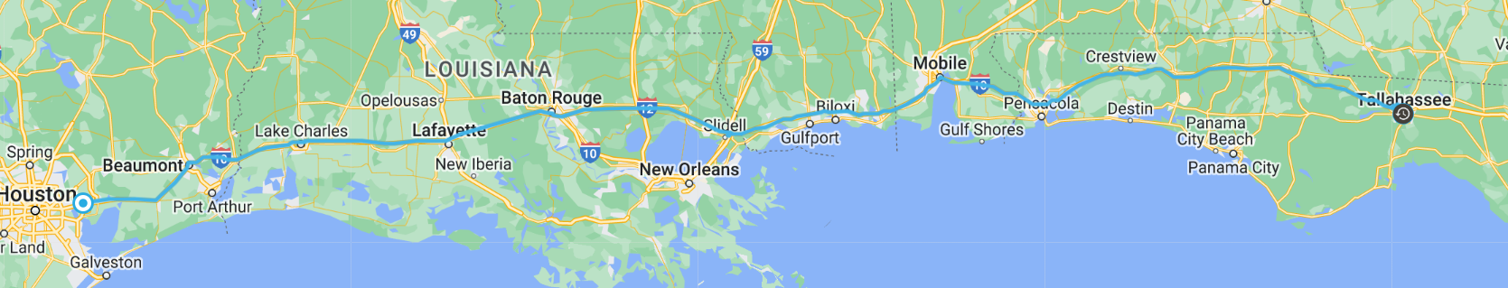
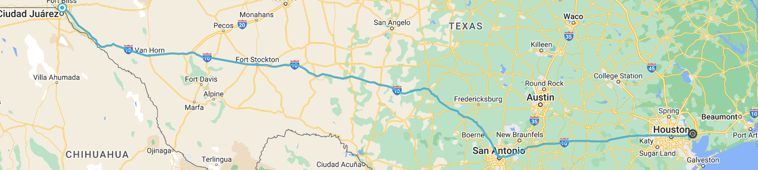
TRANSPORT TO CALIFORNIA
Date | Miles | Time
6/2 | 694 | 11:55
Date | Miles | Time
6/3 | 768 | 11:13

Slide 13
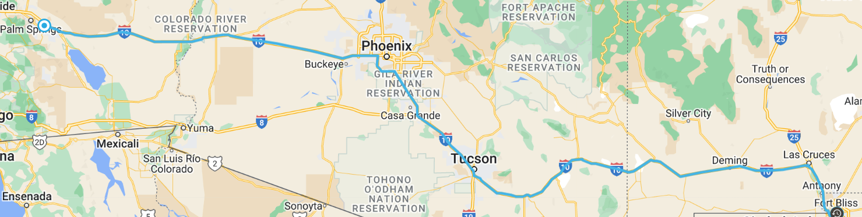
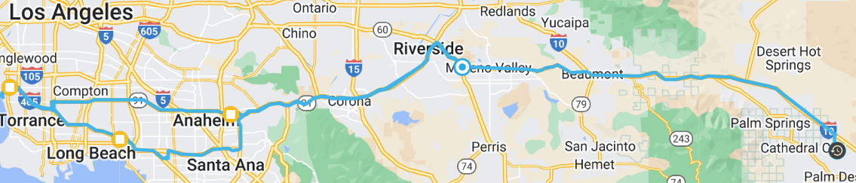
TRANSPORT TO CALIFORNIA
Date | Miles | Time
6/4 | 692 | 10:28
Date | Miles | Time
6/6 | 232.9 | 6:41

Slide 14
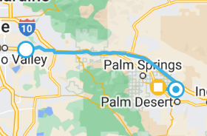
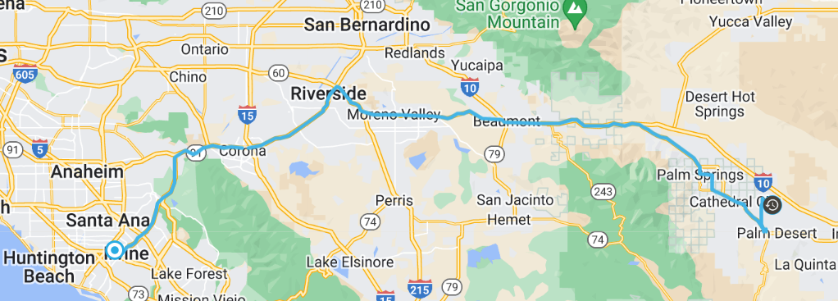
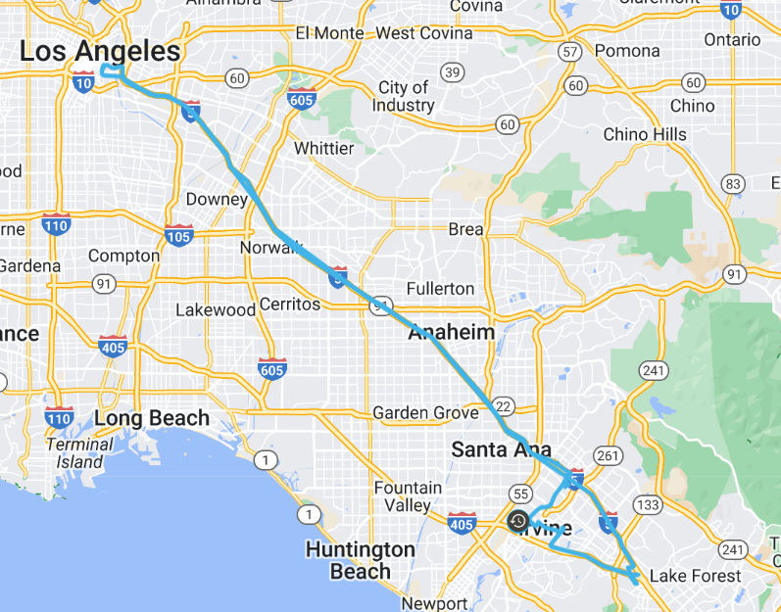
CALIFORNIA
Date | Miles | Time
6/8 | 108 | 2:36
Date | Miles | Time
6/7 | 54.1 | 1:56
Date | Miles | Time
6/9 | 92 | 3:09

Slide 15
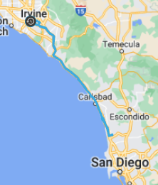
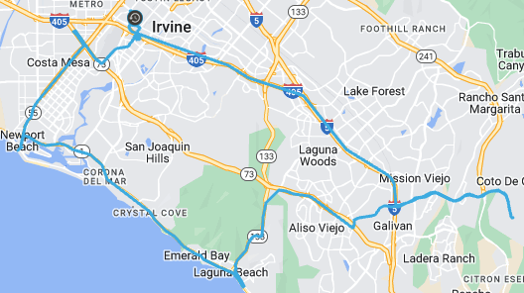
CALIFORNIA
Date | Miles | Time
6/10 | 145 | 4:03
Date | Miles | Time
6/11 | 60 | 2:15

Slide 16
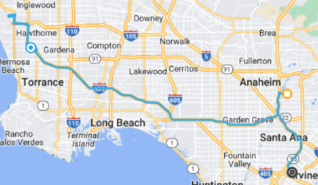
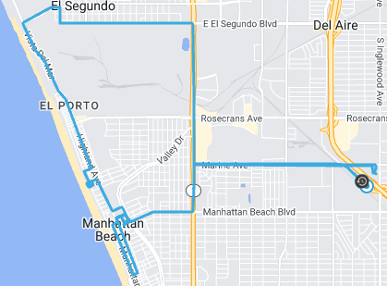
CALIFORNIA
Date | Miles | Time
6/12 | 65 | 3:09
Date | Miles | Time
6/13 | 13 | 1:10

Slide 17
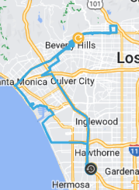
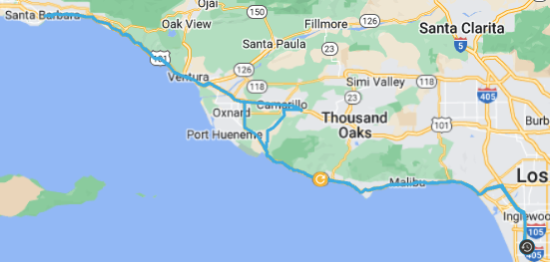
CALIFORNIA
Date​ | Miles​ | Time​
6/14​ | 58​ | 4:32​
Date | Miles | Time
6/15 | 207 | 6:11

Slide 18
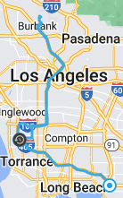
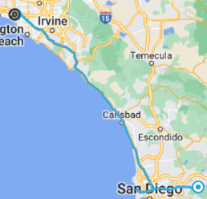
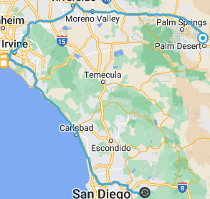
CALIFORNIA
Date | Miles | Time
6/16 | 88.5 | 3:33
Date | Miles | Time
6/17 | 162.5 | 4:30
Date | Miles | Time
6/18 | 219 | 5:38

Slide 19
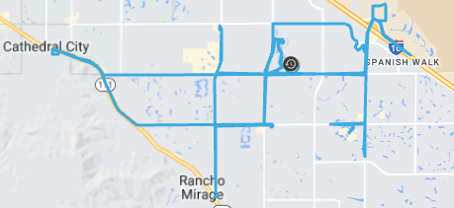
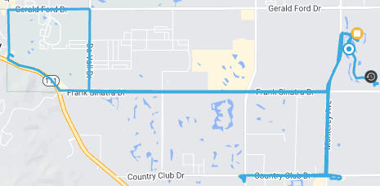
CALIFORNIA
Date | Miles | Time
6/20 | 44 | 2:18
Date | Miles | Time
6/21 | 17 | 1:32

Slide 20
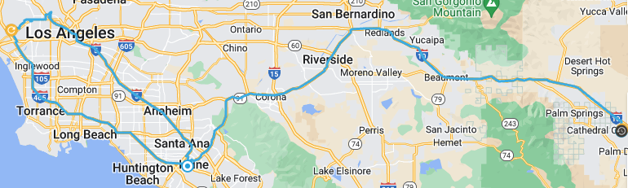
CALIFORNIA
Date | Miles | Time
6/22 | 220 | 8:01

Slide 21
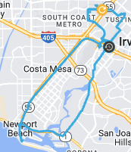
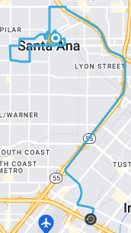
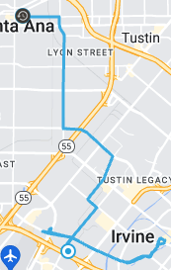
CALIFORNIA
Date | Miles | Time
6/23 | 26 | 1:47
Date | Miles | Time
6/24 | 15 | 1:34
Date | Miles | Time
6/25 | 10 | 57:00

Slide 22
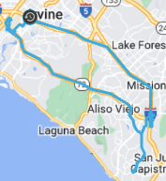
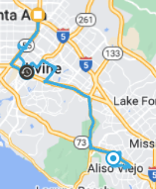

CALIFORNIA
Date | Miles | Time
6/26 | 48 | 1:32
Date | Miles | Time
6/27 | 34 | 1:55
Date | Miles | Time
6/28 | 42 | 2:27

Slide 23


CALIFORNIA
Date | Miles | Time
6/29 | 46 | 1:37
Date | Miles | Time
6/30 | 4 | 21:00

Slide 24



CALIFORNIA
Date | Miles | Time
7/2 | 158 | 6:31
Date | Miles | Time
7/3 | 98 | 4:03
Date | Miles | Time
7/4 | 101 | 4:23

Slide 25


CALIFORNIA
Date | Miles | Time
7/5 | 129.8 | 3:56
Date | Miles | Time
7/6 | 3.3 | 11:00

Slide 26


CALIFORNIA
Date | Miles | Time
7/7 | 345.6 | 7:29
Date | Miles | Time
7/8 | 171.4 | 4:36

Slide 27


CALIFORNIA
Date | Miles | Time
7/9 | 554 | 10:55
Date | Miles | Time
7/10 | 95.7 | 3:21

Slide 28



CALIFORNIA
Date | Miles | Time
7/11 | 249.3 | 7:26
Date | Miles | Time
7/12 | 78 | 1:46
Date | Miles | Time
7/13 | 83 | 4:24

Slide 29


CALIFORNIA
Date | Miles | Time
7/16 | 126 | 4:08
Date | Miles | Time
7/17 | 20 | 1:54

Slide 30


CALIFORNIA
Date | Miles | Time
7/18 | 99 | 4:25
Date | Miles | Time
7/20 | 128 | 5:07

Slide 31


CALIFORNIA
Date | Miles | Time
7/21 | 63 | 1:43
Date | Miles | Time
7/22 | 204 | 4:49

Slide 32


CALIFORNIA
Date | Miles | Time
7/23 | 16 | 36:00
Date | Miles | Time
7/24 | 27 | 1:31

Slide 33


CALIFORNIA
Date | Miles | Time
8/6 | 80 | 2:32
Date | Miles | Time
8/7 | 155 | 4:13

Slide 34



CALIFORNIA
Date | Miles | Time
8/11 | 230 | 6:37
Date | Miles | Time
8/12 | 28 | 1:12
Date | Miles | Time
8/14 | 54 | 2:03

Slide 35



CALIFORNIA
Date | Miles | Time
8/15 | 17 | 1:23
Date | Miles | Time
8/16 | 187.7 | 5:05
Date | Miles | Time
8/17 | 42.3 | 1:13

Slide 36


TRANSPORT TO TEXAS
Date | Miles | Time
8/18 | 13 | 52:00
Date | Miles | Time
8/19 | 460 | 8:51

Slide 37

TRANSPORT TO TEXAS
Date | Miles | Time
8/21 | 340 | 6:13

Slide 38


TRANSPORT TO TEXAS
Date | Miles | Time
8/22 | 564 | 10:25
Date | Miles | Time
8/23 | 23 | 1:47

Slide 39



TEXAS
Date | Miles | Time
8/25 | 48 | 2:27
Date | Miles | Time
8/26 | 23 | 1:06
Date | Miles | Time
8/27 | 42 | 1:06

Slide 40



TEXAS
Date | Miles | Time
9/1 | 251 | 4:27
Date | Miles | Time
9/2 | 19 | 1:28
Date | Miles | Time
9/3 | 19 | 55

Slide 41



TEXAS
Date | Miles | Time
9/6 | 82 | 3:01
Date | Miles | Time
9/7 | 70 | 2:33
Date | Miles | Time
9/8 | 48 | 2:10

Slide 42



TEXAS
Date | Miles | Time
9/9 | 223 | 5:05
Date | Miles | Time
9/11 | 380 | 6:49
Date | Miles | Time
9/15 | 56 | 3:05

Slide 43




TEXAS
Date | Miles | Time
9/16 | 9 | 2:22
Date | Miles | Time
9/17 | 9 | 38
Date | Miles | Time
9/18 | 18 | 1:02
Date | Miles | Time
9/20 | 34 | 2:09

Slide 44



TEXAS
Date | Miles | Time
9/22 | 186 | 4:30
Date | Miles | Time
9/23 | 12 | 55:00
Date | Miles | Time
9/24 | 7 | 44:00

Slide 45
TEXAS
Date | Miles | Time
9/22 | 186 | 4:30
Date | Miles | Time
9/23 | 12 | 55:00
Date | Miles | Time
9/24 | 7 | 44:00

Slide 46
TEXAS
Date | Miles | Time
9/22 | 186 | 4:30
Date | Miles | Time
9/23 | 12 | 55:00
Date | Miles | Time
9/24 | 7 | 44:00

Slide 47
TEXAS
Date | Miles | Time
9/22 | 186 | 4:30
Date | Miles | Time
9/23 | 12 | 55:00
Date | Miles | Time
9/24 | 7 | 44:00

Slide 48


TEXAS
Date | Miles | Time
9/29 | 60.0 | 2:07
Date | Miles | Time
9/30 | 90.0 | 4:57

Slide 49


TEXAS
Date | Miles | Time
10/1 | 6 | 1:01
Date | Miles | Time
10/2 | 33 | 1:03

Slide 50



TEXAS
Date | Miles | Time
10/3 | 87 | 3:36
Date | Miles | Time
10/4 | 58 | 2:10
Date | Miles | Time
10/5 | 97 | 3:36

Slide 51


TEXAS
Date | Miles | Time
10/6 | 76 | 3:02
Date | Miles | Time
10/7 | 78 | 3:39

Slide 52


TEXAS
Date | Miles | Time
10/11 | 202 | 4:39
Date | Miles | Time
10/12 | 48 | 2:13

Slide 53


TEXAS
Date | Miles | Time
10/13 | 61 | 5:02
Date | Miles | Time
10/14 | 102 | 6:40

Slide 54



TEXAS
Date | Miles | Time
10/15 | 15 | 1:02
Date | Miles | Time
10/16 | 19 | 1:48
Date | Miles | Time
10/17 | 49 | 2:14

Slide 55



TEXAS
Date | Miles | Time
10/18 | 27 | 1:02
Date | Miles | Time
10/22 | 31 | 1:22
Date | Miles | Time
10/24 | 33 | 2:48

Slide 56


TEXAS
Date | Miles | Time
10/25 | 113 | 4:48
Date | Miles | Time
10/26 | 5 | 0:35

Slide 57



TEXAS
Date | Miles | Time
10/27 | 9 | 1:17
Date | Miles | Time
10/28 | 256 | 5:18
Date | Miles | Time
10/29 | 5 | 0:28

Slide 58



TEXAS
Date | Miles | Time
10/30 | 81 | 4:20
Date | Miles | Time
10/31 | 23 | 1:30
Date | Miles | Time
11/1 | 6 | 2:13

Slide 59



TEXAS
Date | Miles | Time
11/2 | 225 | 6:00
Date | Miles | Time
11/3 | 44 | 3:06
Date | Miles | Time
11/5 | 10 | 0:25

Slide 60


TEXAS
Date | Miles | Time
11/6 | 40 | 2:17
Date | Miles | Time
11/7 | 171 | 4:30

Slide 61


TEXAS
Date | Miles | Time
11/8 | 29 | 1:47
Date | Miles | Time
11/9 | 43 | 2:20

Slide 62


TEXAS AND TRANSPORT TO ST. LOUIS
Date | Miles | Time
11/12 | 6 | 1:04
Date | Miles | Time
11/13 | 447 | 8:03

Slide 63


TRANSPORT TO ST. LOUIS
Date | Miles | Time
11/14 | 371 | 6:38
Date | Miles | Time
11/15 | 13 | 0:35

Slide 64
THANK YOU

